Slide 1
WiFi Indoor Positioning System
B06901057 紀彥仰
B06502055 許元譯

Slide 2
Training Pprocess
STM32 (Raspberry Pi) reading WiFi data (MAC address, RSSI)
^{Send the data to server}
^{Label the data manually}
Select the most k frequent MAC address and the corresponding RSSI to be the feature
^{Train the model (DNN for now)}

Slide 3
Testing Process
STM32 reading WiFi data (MAC address, RSSI)
^{Send the data to server}
Feed the data into the model and output the result
^{Visualization the result}

Slide 4
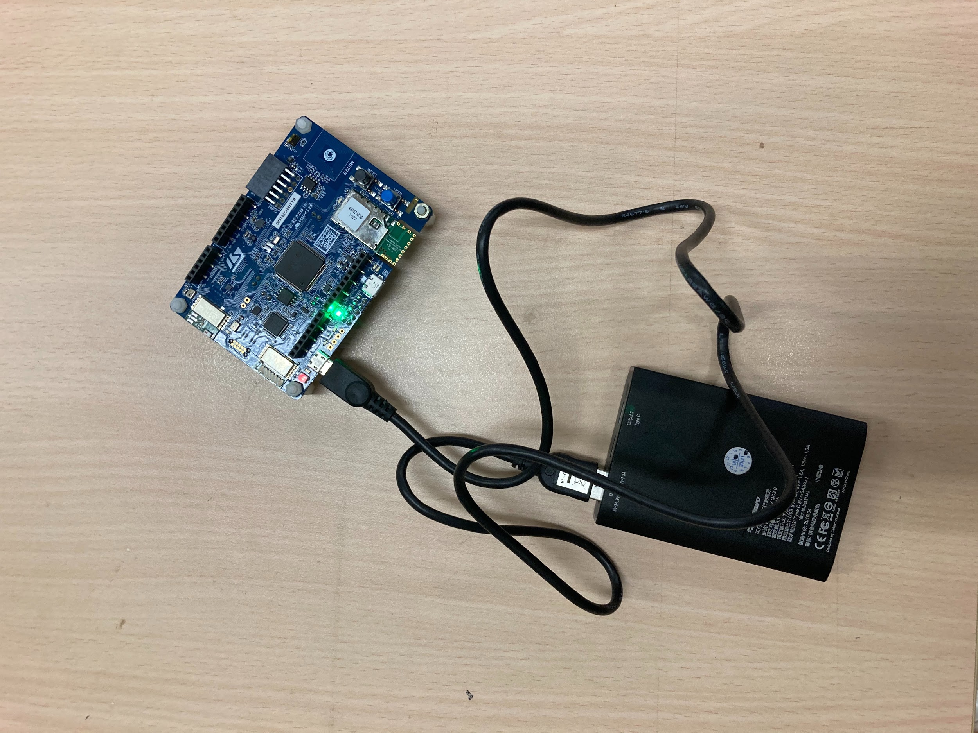
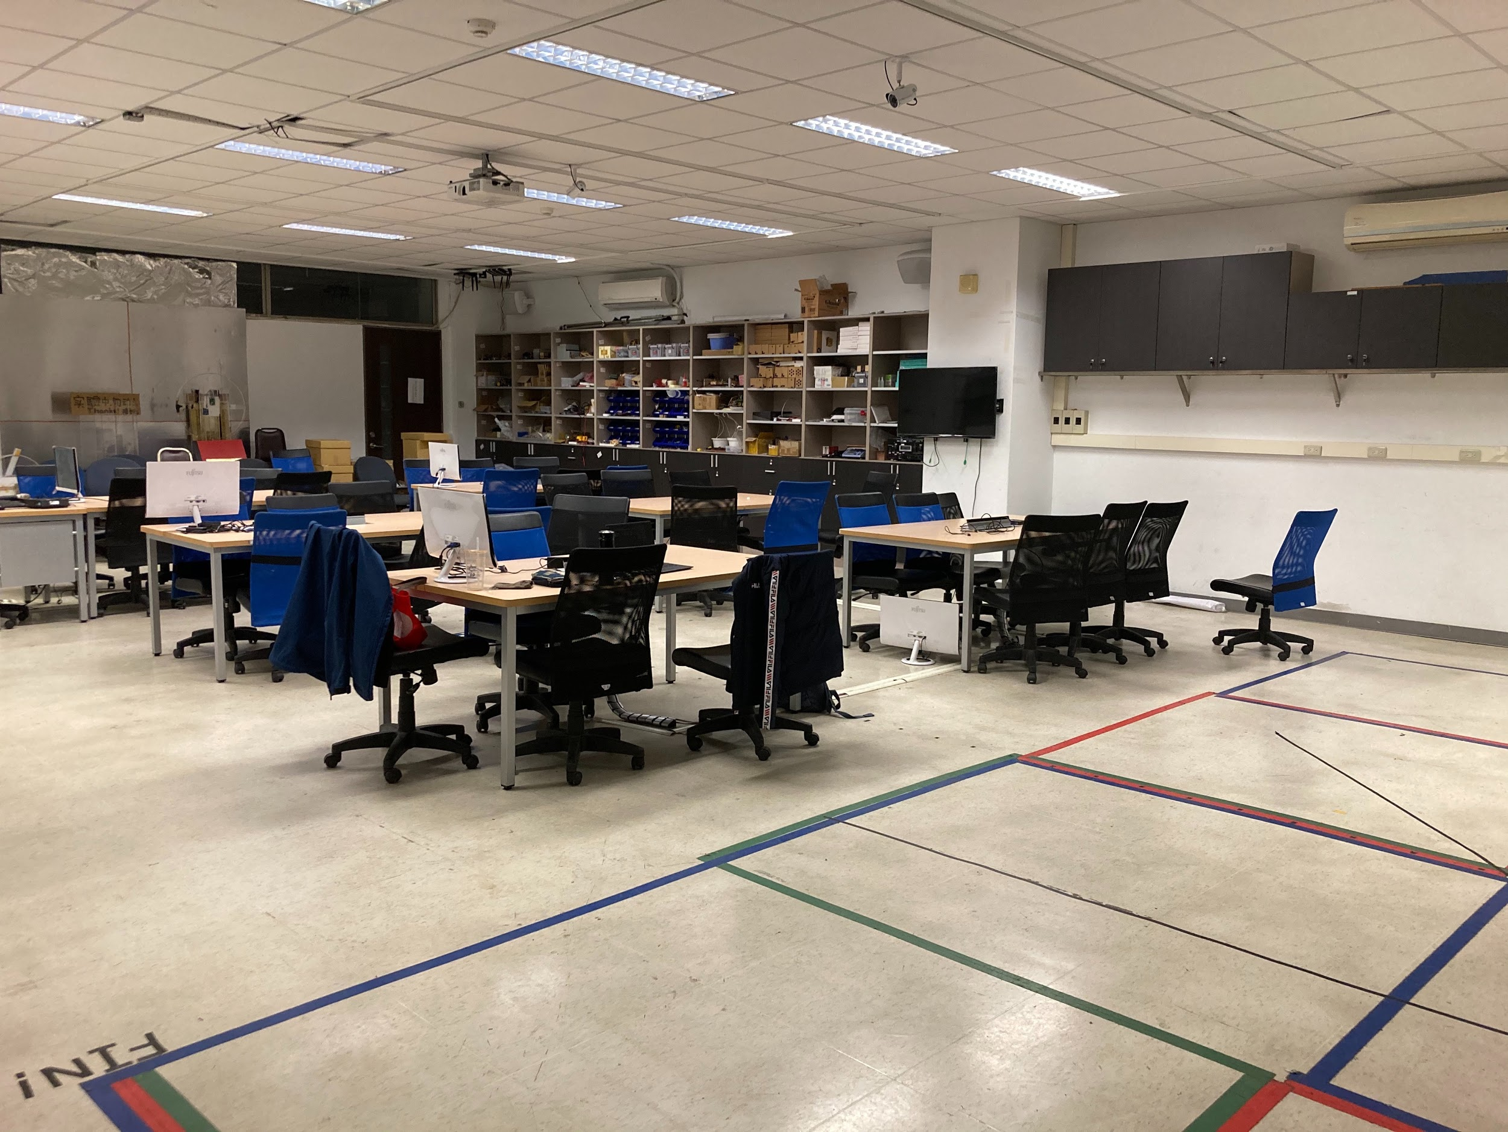
Testing Settings
^{MD402}
^{Classroom size: 1200cmｘ720cm}
^{Split into 10ｘ6 grids}
^{Grid size: 120cmｘ120cm}

Slide 5
Testing Result
Mean L2-distance with ground truth: 1m
STM32 WiFi reading WiFi slowly (8 sec / data)

Slide 6
Visualization
^{https://youtu.be/NUC1zSgwCPY}

